Slide 1
Air Rights and Data analysis
By Jacquilene Jacob

Slide 2

What are air rights?
Notes:
A development includes the construction of a new building or other structure on a zoning lot, the relocation of an existing building to another lot, or the use of a tract of land for a new use.
Development rights →maximum amount of floor area permissible on a zoning lot.
Air rights→ difference between the maximum permitted floor area and actual floor area is referred to as “unused development rights.”

Slide 3
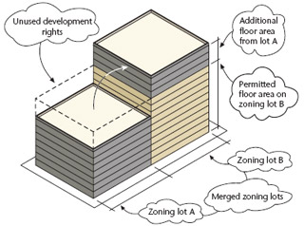
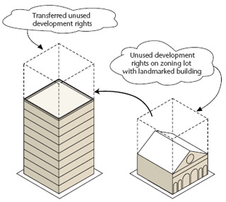
Zoning lot merger Transfer of development rights
Notes:
A zoning lot merger is the joining of two or more adjacent zoning lots into one new zoning lot. Unused development rights may be shifted from one lot to another, as-of-right, only through a zoning lot merger.
A transfer of development rights (TDR) allows for the transfer of unused development rights from one zoning lot to another in special circumstances, usually to promote the preservation of historic buildings, open space or unique cultural resources.

Slide 4
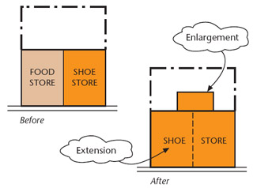
Extension and Enlargement
Notes:
Enlargement* An enlargement is a built addition to an existing building that increases the floor area of the building. Extension* An extension is an expansion of the existing floor area occupied by an existing use

Slide 5
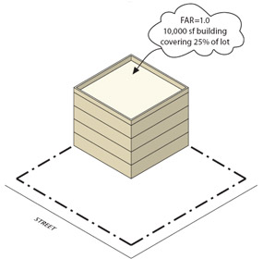
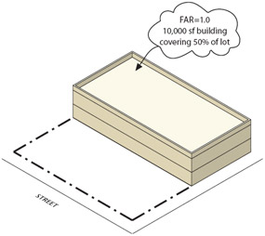
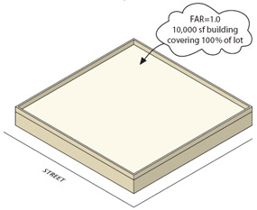
Floor Area
Notes:
The floor area of a building is the sum of the gross area of each floor of the building, excluding mechanical space, cellar space, floor space in open balconies, elevators or stair bulkheads and, in most zoning districts, floor space used for accessory parking that is located less than 23 feet above curb level
Floor Area Ratio (FAR)* The floor area ratio (FAR) is the principal bulk regulation controlling the size of buildings. FAR is the ratio of total building floor area to the area of its zoning lot. Each zoning district has an FAR control which, when multiplied by the lot area of the zoning lot, produces the maximum amount of floor area allowable in a building on the zoning lot. For example, on a 10,000 square-foot zoning lot in a district with a maximum FAR of 1.0, the floor area of a building cannot exceed 10,000 square feet.

Slide 6

What would the architect want to see?

Slide 7
Data for kinds of buildings
Residential Units
Year built
Building class
Commercial units
Year built
Year built
Toxic sites
Rent Price
Rented date
Unused buildable square feet
Zoning map
Zoning district
Building class
Unused buildable square feet
Zoning map
Zoning district
Campus buildings
Unused buildable square feet
Zoning map
Zoning district
Buildings around
Rent/Sale price
Cost of infrastructure
Notes:
The segregation of the different building units on the basis of occupancy and the data corresponding to each of these are depicted as well.

Slide 8
Data for Interaction
1.Address of surrounding buildings
2.Air rights available
1.Address
2.Height of building
3.Transferable air rights
4. Violated air rights
Finding a Lot
Tinker with building
Add/subtract floor
Surrounding buildings for Air Rights
1.Air rights available
2. Violated air rights
3.Total square feet area.
1.Square feet area before
2.Square feet area after
3.Air rights transferred, bought or leased

Slide 9
Dynamic data on manipulation of air rights on buildings
Purchase price
Total square feet
Air rights transferred.
Number of floors added or subtracted
Rents for housing
Occupancy
Current Occupancy
Total cost of construction
Property value
V
A
L
U
E
S
For
old
V
A
L
U
E
S
for
new
Old
New
Notes:
On selection and manipulation of the building for operations required by user, these data are shown for the old and new structures.

Slide 10
DATA
Graph showing the varying height s of neighborhood buildings
1.Height of the building
2.Height allowed
3.Address of the building
4.Tranferable air rights
5. Unused air rights
Graph of unused air rights over years
Graph of allowed and violated heights
Graphs of transferable air rights for buildings against year.
Notes:
On click of each building in the block, the following data is shown which gives general information of the building.
Corresponding to each of the data a graphical display of the comparisons of these parameters is shown.

